Slide 1

Agile Enterprise Architecture
Experience Design

Slide 2
Outline
Overview
Generic approach
Work products
Deliverable template

Slide 3
Generic approach
Agile Strategy*
Agile
Organization
Applicability
Inverse Conway Maneuver
Concurrent Engineering
Business Unit
Product Architecture
Top-down
Bottom
up
Roadmap
Value Area**
Experience Design
Operations Architecture
Platform Architecture
Bottom
up
Optional Pilot
Top-down
Software/Hardware Architecture
Product***
Evolution
* Or classical strategy
** Product/market segmentation
Learning cycle
*** Project when the shift to Product has not occurred yet

Slide 4
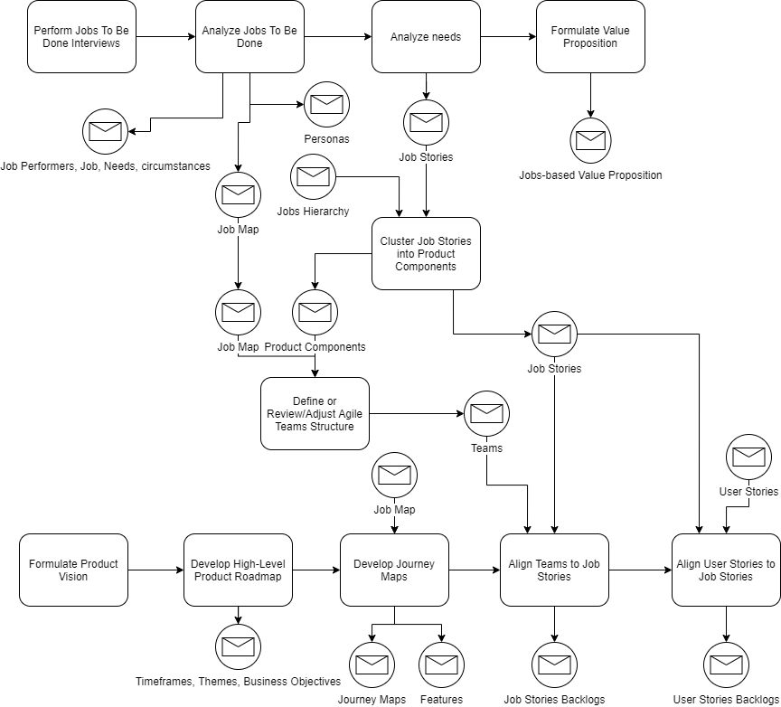
Experience Design
Problem Space
Solution Space
(one or more scenarios)

Slide 5
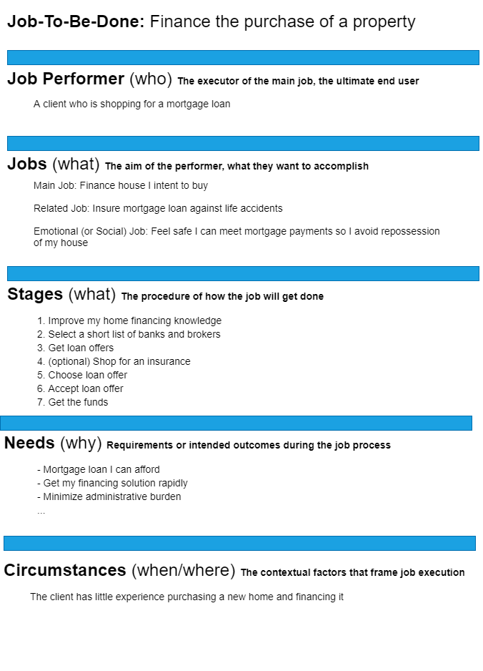
JTBD Template
A job is a goal or an objective independent of your solution
A job statement is Verb + Object + Clarifier
It shouldn’t include adjectives like quick, easy, or inexpensive which are needs
The aim of the job performer is not to interact with your company, but to get something done
Your service is a means to an end, and you must first understand that end
Strive to frame jobs in a way that makes them stable, even as technology changes
Install Draw-io :
https://draw-io.en.softonic.com/
Double click on the icon below:
Source: Jim Kalbach, The Jobs To Be Done Playbook

Slide 6
Needs
Desired outcome statements.
Direction of change + unit of measure + object + clarifier
Direction of change
How does the job performer want to improve conditions? Each need statement starts with a verb showing the desired change of improvement. Words like “minimize,” “decrease,” or “lower” show a reduction of unit of measure, while words like “maximize,” “increase,” and “raise” show an upward change
Unit of measure
What is the metric for success?
Object of the need
What is the need about? Indicate the object of control that will be affected by doing a job
Clarifier
What else is necessary to understand the need?

Slide 7
Job Levels
“So not only do you have to move up and down in granularity, you also need to move from side to side and recognize adjacent goals. Related jobs can help you break up a big job into more meaningful sections.”
Jim Kalbach, The Jobs To Be Done Playbook
Level | Examples
Aspiration | Enjoy a home that meets the needs of a family that is teleworking
Big Job (L0) | Provide a physical workspace to each family member
Smaller Job (L1) | Get Internet access to all my devices
Smaller Job (L2) | …
…
Micro Job | Drink coffee at my desk
Higher Level Job
How?
Lower-Level Jobs
Why?

Slide 8
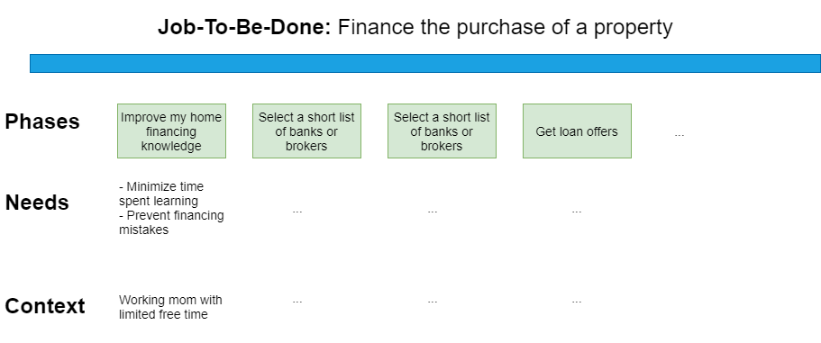
Job Map
““A Jobs Map is a view into the behaviors and needs of individuals in the context of their daily lives. That may or may not include your solution.”
Jim Kalbach, The Jobs To Be Done Playbook
A Job Map is not a Journey map
It is not about how people come to your solution, decide to purchase or stay loyal
Help discover specific innovative ideas to fulfill a job
Install Draw-io :
https://draw-io.en.softonic.com/
Double click on the icon below:

Slide 9
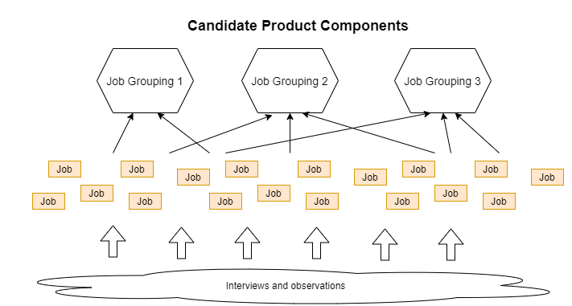
Architecting Products
Good solutions mirror clients’ mental model of their Job-To-Be-Done
Look for affinities among jobs
Unlike a job map, which is chronological, a model of the solution will typically have no temporal component
By matching the structure people naturally use in practice, you can set up a lasting foundation for iterating your product
Young, Indi. Mental Models . Rosenfeld Media

Slide 10
Job Story vs. User Story
A job story should make sense without having to know the larger JTBD landscape or job map. As a result, job stories have a more “plug-and-play” versatility that is often required for Agile designs and development teams.
Jim Kalbach, The Jobs To Be Done Playbook
Although User Stories are good for breaking down work, they typically fail to connect the solution with user needs and they lack an indication of why someone would behave in a certain way and what they need to get a job done
Often User Stories are derived from the capability being built, not from observing actual behavior
Job Stories are an alternative to User Stories. They follow the tradition of breaking down efforts into smaller pieces, but through the JTBD lens
Examples of Job Story Formats
When I [circumstance], I want to [job], so I can [expected outcome]
When I [circumstance + job stage/step], I want to [micro-job], so I can [need]

